Slide 1
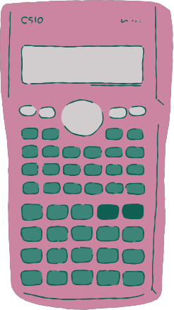
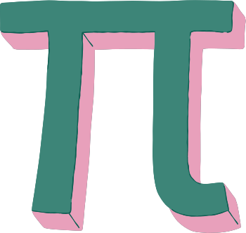
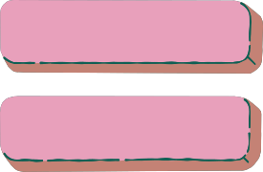
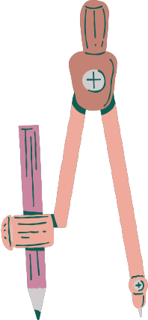


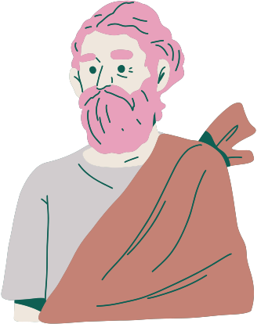
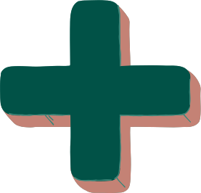
DATE:________________
H1. PRISMS
Indicator: To classify solids or flat figures according to their properties.

Slide 2
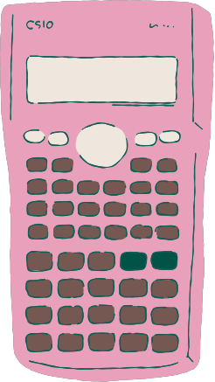
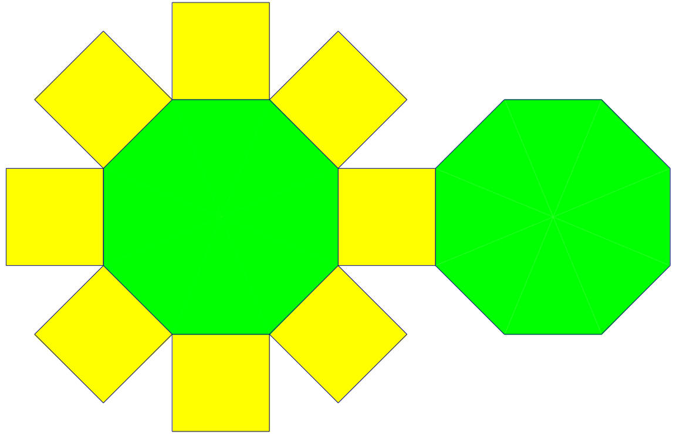


WARM-UP:
MINI CHALLENGE
If you fold the net, which solid can be formed?
https://www.youtube.com/watch?v=CYVmmTaqIPU
Learn About Faces, Edges and Vertices - 3D Shapes

Slide 3

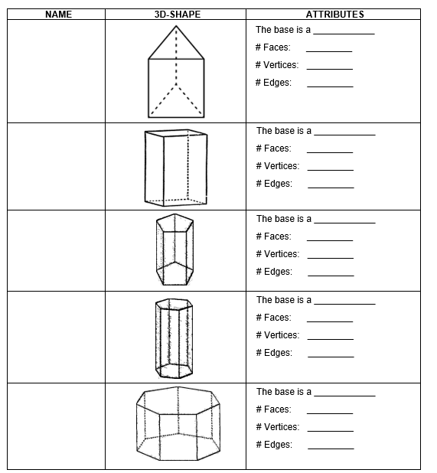


ACTIVITY: COMPLETE THE CHART
Triangle
5
Triangular prism
6
9

Slide 4
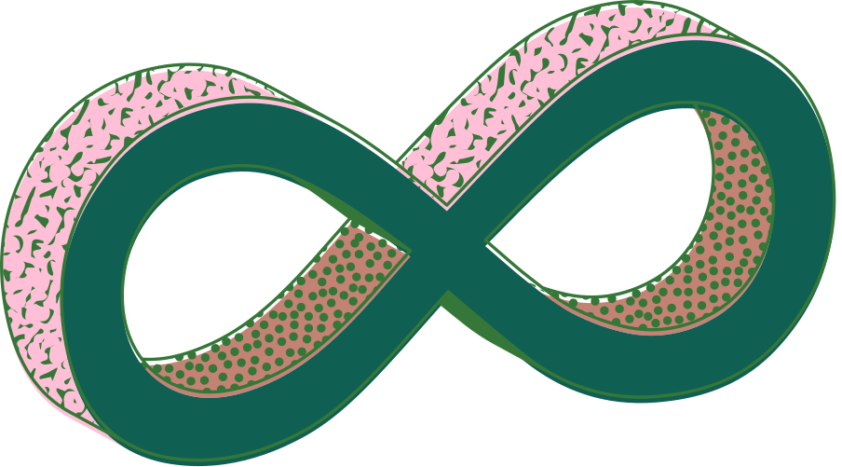

Rectangle
6
Rectangular prism
8
12
Pentagon
7
Pentagonal prism
10
15

Slide 5
Hexagon
8
Hexagonal prism
12
18
Heptagon
9
Heptagonal prism
14
21

Slide 6
DATE:________________
H2. PYRAMIDS
Indicator: To classify solids or flat figures according to their properties.

Slide 7
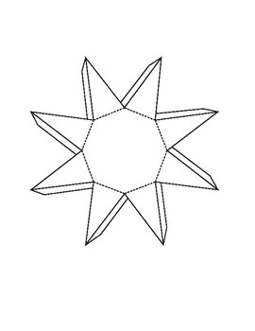
WARM-UP:
MINI CHALLENGE
If you fold the net, which solid can be formed?
https://www.youtube.com/watch?v=s1OpVWkTotY
Pyramid | Prism and Pyramids

Slide 8
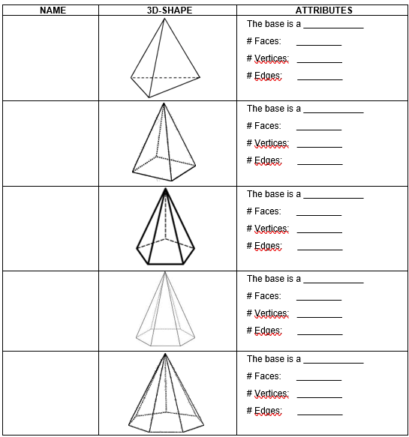
ACTIVITY: COMPLETE THE CHART
Triangle
4
Triangular pyramid
4
6

Slide 9
Square
5
Square pyramid
5
8
Pentagon
6
Pentagonal pyramid
6
10

Slide 10
Hexagon
7
Hexagonal pyramid
7
12
Heptagon
8
Heptagonal pyramid
8
14

Slide 11
DATE:________________
H3. ROUND SHAPES
Indicator: To classify solids or flat figures according to their properties.

Slide 12
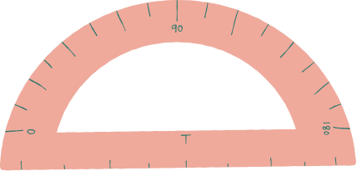
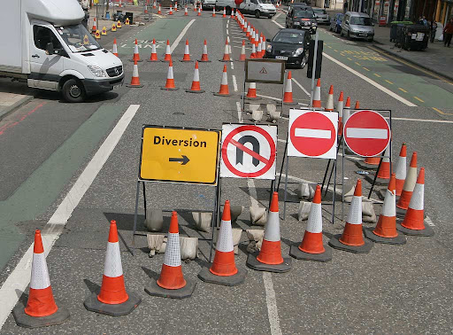

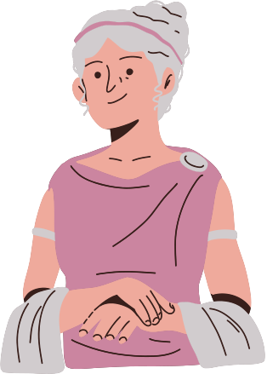
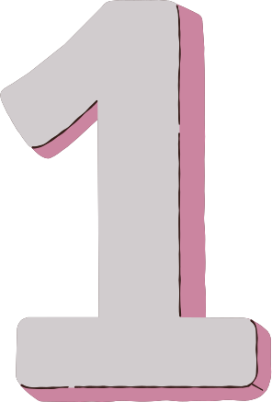

https://wordwall.net/resource/51779311/3d-shapes-faces-edges-vertices
3D Shapes: Faces, Edges & Vertices

Slide 13
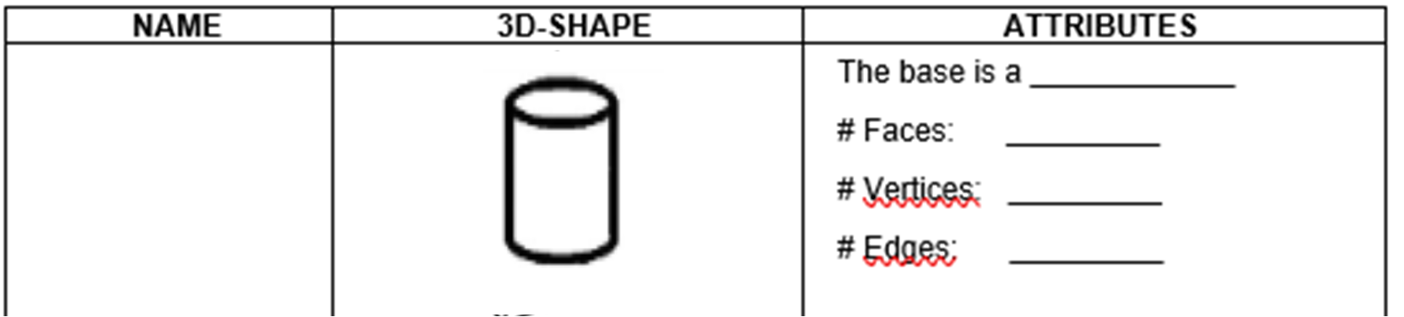
ACTIVITY: COMPLETE THE CHART
Circle
2
Cylinder
0
2

Slide 14
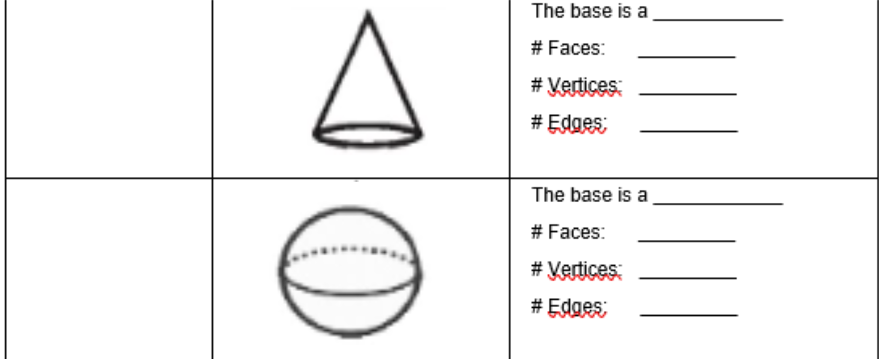
Circle
1
Cone
1
1
Does not have a base
0
Sphere
0
0

Slide 15
PRÁCTICAS MÍNIMAS
Solve exercise 14 page 71 of the book "Saber SABER".
(Copy dates on the page)
Evalúa tu Saber

Slide 16
WRAP-UP:
https://wordwall.net/resource/23289568/3d-shapes-faces-edges-vertices
3D shapes -Faces, Edges & Vertices-Match Up

